Slide 1


Getting started with JavaFX
Presenter: Vladimir Conev
Junior Developer at Oracle Technologies

Slide 2

Agenda
JavaFX overview
JavaFX Architecture
Swing-JavaFX Interoperability
Simple JavaFX demo app using FXML

Slide 3
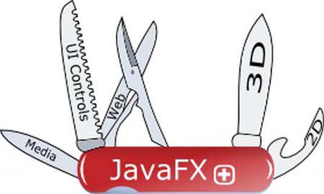
1. JavaFX Overview
1.1 What is JavaFX?
JavaFX provides a toolkit that helps both the developer and designer (in some cases, they happen to be the same person) to create functional yet esthetically pleasing applications.

Slide 4
1.2 JavaFX Applications and Key features
Advantages of JavaFX:
unified development and deployment model for building expressive RIAs across desktop, browser, mobile and TV
easy and intuitive to integrate graphics, video, audio, animation and rich text
ready-made mass market: distribute your app, more quickly and easily across Java-powered devices
reuse your existing Java code
enables you to integrate a rich UI with a complex enterprise back-end
dramatically shortened production cycle for designers and developers

Slide 5
1.2 JavaFX Applications and Key features
JavaFX APIs are available as a fully integrated feature of the JDK and JRE (JavaSE 7 or later).
Key Features introduced in JavaFX 8 release:
FXML and Scene Builder
WebView (WebKitHTML technology)
Swing interoperability
Built-In UI controls and CSS (DatePicker, TreeTableView)
Modena Theme (default theme)
3D graphics features
Multitouch support
Hi-DPI support (Retina Displays)

Slide 6

1.3 Getting started
Download and Install JDK 7 or later
use your favourite IDE that supports Java: Netbeans, IntelliJ Idea, Eclipse
Install JavaFX Scene Builder 1.1 (early access 2.0)
You are now prepared to create your very first JavaFX app.
Recommended readings:
http://docs.oracle.com/javase/8/javase-clienttechnologies.htm
http://docs.oracle.com/javafx/2/get_started/jfxpub-get_started.htm

Slide 7
1.3 Getting started
Entry point for every JavaFX app is the Application class. JavaFX runtime does the following whenever an app is launched:
Construct instance of the specified Application class
Calls init() method
Calls the start(javafx.stage.Stage) method
Waits for the app to finish if the app invokes Platform.exit() or the last window has been closed and the implicitExit attribute on Platform is TRUE
Calls the stop() method
start() is abstract method and must be overridden.

Slide 8

1.3 Getting started
odd names: Stage & Scene; The API designers have modeled things very similar to a theater (one-to-many scenes that actors performs in and all scenes are performed on a stage)
Stage is equivalent to an application window similar with Swing API JFrame or JDialog
Scene is a content pane that can hold zero-to-many Node objects
Node is fundamental base class for all scene graph nodes to be rendered (UI controls and Shape)

Slide 9
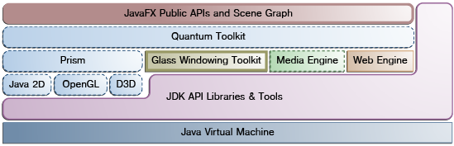
2. Understanding JavaFX Architecture

Slide 10
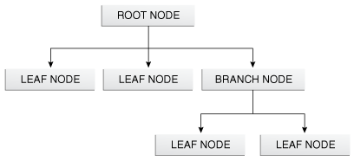
2.1 Scene graph
starting point for constructing a JavaFX app
hierarchical tree of nodes representing all visual elements of UI
maintains an internal model of all graphical objects in your app
instead of invoking primitive drawing methods directly, you can use scene graph API and let the system automatically handle the rendering details
individual items held within JavaFX scene graph are known as nodes

Slide 11



2.2 Java Public APIs for JavaFX features
most of the JavaFX APIs have been directly ported to Java
provides complete set of APIs that support rich client application development
these new Java APIs for JavaFX features allow: usage of Java features (generics, annotations, multithreading, Lamda expressions), usage of binding and extends Java Collection library to provide observable list and maps to wire UI to data model
use popular JVM-based scripting languages as Groovy, JRuby, Scala

Slide 12
2.3 Graphics system
Supports 2D and 3D scene graphs. Provides software rendering when the hardware on the system is insufficient.
Two accelerated graphics pipelines are implemented in JavaFX platform:
Prism (process render jobs and it is responsible for rasterization and and rendering of JavaFX scenes)
Quantum Toolkit: ties Prism and Glass Windowing toolkit and manages the threading rules related to rendering vs. event handling

Slide 13
2.4 Glass Windowing Toolkit
Responsible for obtaining native operating services: managing windows,timers,surface and management of event queues.
Serves as platform dependent layer that connects JavaFX platform to the operating system.
Uses native OS event queue functionality to schedule thread usage and runs on the same thread as JavaFX app (unlike AWT).
Media and Images: available throw javafx.scene.media APIs and supports both video and audio media (not depended on underlying OS)

Slide 14
2.5 Web Component
JavaFX UI control, based on WebKit (http://www.webkit.org/) and provides WebView and full browsing functionality through its API. Supports HTML5, CSS, JavaScript, DOM and SVG.
Enables the following features to the developers:
render HTML content from local or remote URL
back and forward support
reload content
apply effects to web components
edit HTML content
execute Java Script commands
handle events

Slide 15

3. Interoperability of JavaFX and Swing
Some of today's most popular GUI features cannot be easily implemented by using Swing (example: panning gesture on touch screens). Meeting these new requirements will force the developers to use JavaFX in combination with Swing or migrate their Swing app to JavaFX.
Useful links:
http://docs.oracle.com/javafx/2/swing/jfxpub-swing.htm
http://www.youtube.com/watch?v=bR8ctoWTPKg

Slide 16
3.1 JavaFX Advantages for Swing developers
FXML
JavaFX Scene Builder
CSS support
JavaFX Media support
Animation
HTML content
3D Tooling support with Scene Builder
Why replace Swing?
Incomplete Look and Feel support
Lacks multi touch support
Poor component extensibility

Slide 17
3.2 Enriching Swing app with JavaFX functionality
The ability to embed JavaFX content in Swing app has existed since JavaFX 2.0 release.
javafx.embeds.swing.JFXPanel
-component to embed JavaFX content into Swing app
- content to be displayed is specified with the setScene(javafx.scene.Scene) method
- restrictictions: JavaFX scene must be created on JavaFX Application thread and you should wrap your code into a Runnable object
Platform.runLater(new Runnable() { @Override public void run() { createScene(); } });

Slide 18
3.2 Enriching Swing app with JavaFX functionality
Swing-JavaFX Interoperability and Threads
Two scenarios:
JavaFX data change is triggered by a change in Swing data
Swing data change is triggered by a change in JavaFX data
Solution: JavaFX data should be accessed only on JavaFX User thread and Swing data should be changed on EDT

Slide 19
3.3 Embedding Swing content in JavaFX app
JavaFX 8 introduced a new class that provides reverse integration and enables to developers to embed Swing components in JavaFX app.
SwingNode class located in javafx.embed.swing package
enables you to embed Swing content in JavaFX app if you have JDK 8 installed
to set content of SwingNode object, setContent(javax.swing.JComponent) method is invoked either on EDT or JavaFX Application Thread
to access Swing content, ensure that your code runs on EDT

Slide 20
4. JavaFX demo app using FXML
This page is intentionally left blank.

Slide 21


